Slide 1
SQL Queries – misc. and relational algebra

Slide 2
Overview of this video
Provide a better understanding of SQL queries as a whole, instead of as parts
(Relational algebra does focus on parts, but should let you better see how the parts compose, which is the point)

Slide 3
SQL Queries
Queries in SQL have the following form:
SELECT
FROM
WHERE
GROUP BY
HAVING
ORDER BY
This video

Slide 4
SQL Queries
Queries in SQL have the following form:
6. SELECT
1. FROM
2. WHERE
3. GROUP BY
4. HAVING
5. ORDER BY
This video
No. = order of execution

Slide 5
Views: as saved queries
Intuitively, saved queries or virtual tables
Employees
birthday | first_name | family_name | e_id
1990-11-10 | Anne | Smith | 1
2000-02-05 | David | Jones | 2
1995-05-09 | William | Taylor | 3
SELECT first_name, e_id, COUNT(t_id)
FROM Employees NATURAL JOIN Transactions
GROUP BY first_name, e_id;
Transactions
t_id | c_id | e_id
1 | 3 | 1
2 | 6 | 1
3 | 19 | 3
first_name | e_id | COUNT(t_id)
Anne | 1 | 2
William | 3 | 1

Slide 6
Views: as saved queries
Intuitively, saved queries or virtual tables
Employees
birthday | first_name | family_name
1990-11-10 | Anne | Smith
2000-02-05 | David | Jones
1995-05-09 | William | Taylor
CREATE VIEW Employee_transaction_count AS
SELECT first_name, e_id, COUNT(t_id)
FROM Employees NATURAL JOIN Transactions
GROUP BY first_name, e_id;
SELECT first_name, e_id, COUNT(t_id)
FROM Employees NATURAL JOIN Transactions
GROUP BY first_name, e_id;
Transactions
Employee_transaction_count
t_id | c_id | e_id
1 | 3 | 1
2 | 6 | 1
3 | 19 | 3
first_name | e_id | COUNT(t_id)
Anne | 1 | 2
William | 3 | 1

Slide 7
Views: as virtual tables
Intuitively, saved queries or virtual tables
CREATE VIEW Employee_transaction_count AS
SELECT first_name, e_id, COUNT(t_id)
FROM Employees NATURAL JOIN Transactions
GROUP BY first_name, e_id;
Employee_transaction_count
SELECT first_name, COUNT(t_id)
FROM Employee_transaction_count;
first_name | e_id | COUNT(t_id)
Anne | 1 | 2
William | 3 | 1
first_name | COUNT(t_id)
Anne | 2
William | 1

Slide 8
More on views
By default data in views can’t be modified (i.e. updated, delete from or inserted into)
Can be done with triggers, but that is not covered in this module
Views can be modified though:
Or removed:
CREATE OR REPLACE VIEW Employee_transaction_count AS
SELECT first_name, COUNT(t_id)
FROM Employees NATURAL JOIN Transactions
GROUP BY first_name, e_id;
CREATE VIEW Employee_transaction_count AS
SELECT first_name, e_id, COUNT(t_id)
FROM Employees NATURAL JOIN Transactions
GROUP BY first_name, e_id;
DROP VIEW Employee_transaction_count;

Slide 9
Relational Algebra

Slide 10
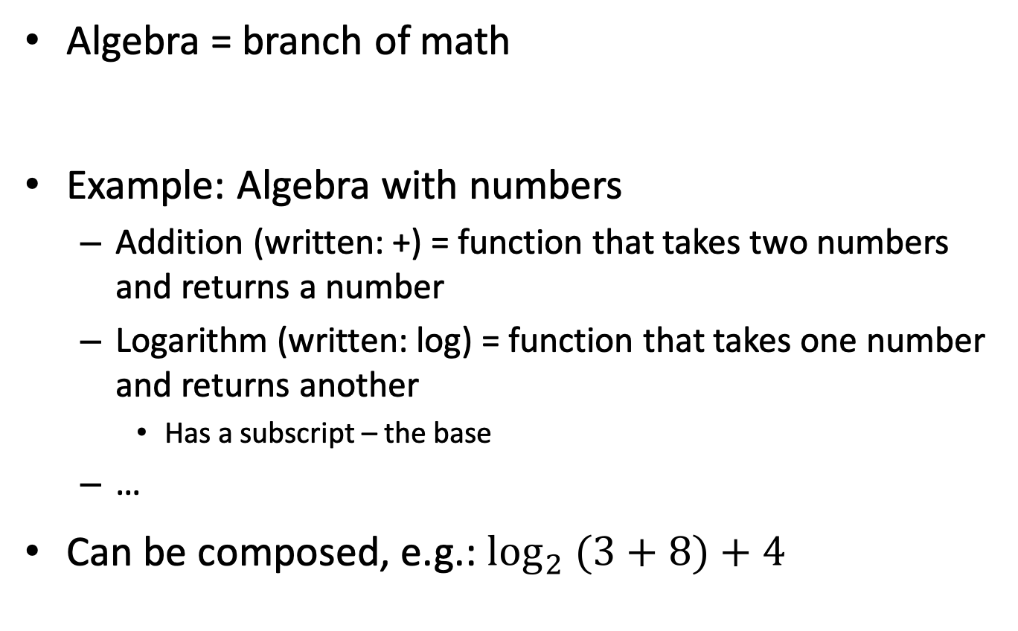
Algebra
Algebra = branch of math
Example: Algebra with numbers
Addition (written: +) = function that takes two numbers and returns a number
Logarithm (written: log) = function that takes one number and returns another
Has a subscript – the base
…
Can be composed, e.g.: $\log_{2} (3+8)+4$

Slide 11
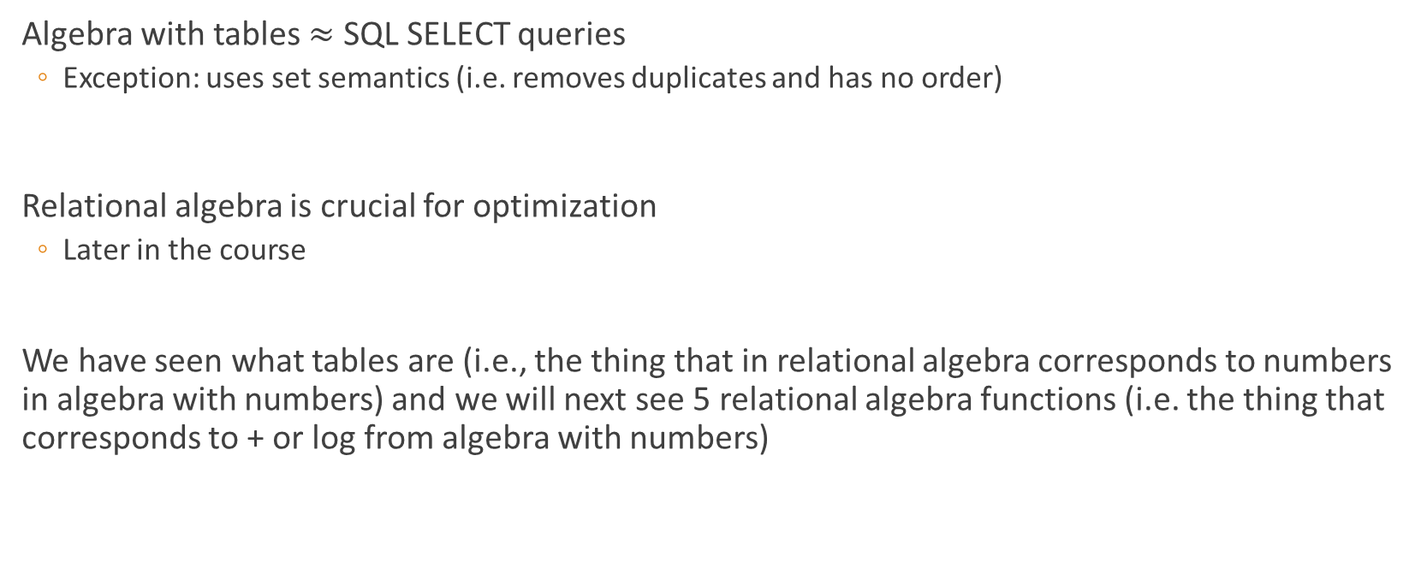
Relational algebra
Algebra with tables $≈$ SQL SELECT queries
Exception: uses set semantics (i.e. removes duplicates and has no order)
Relational algebra is crucial for optimization
Later in the course
We have seen what tables are (i.e., the thing that in relational algebra corresponds to numbers in algebra with numbers) and we will next see 5 relational algebra functions (i.e. the thing that corresponds to + or log from algebra with numbers)

Slide 12

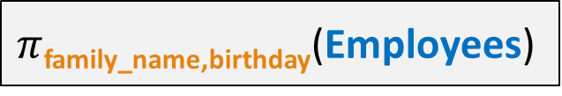
Projection ($π$)
$π$_{attribute list}(R) = restricts R to the attributes in attribute list
SQL query
Employees
SELECT DISTINCT family_name, birthday
FROM Employees;
birthday | first_name | family_name
1990-11-10 | Anne | Smith
2000-02-05 | David | Jones
1995-05-09 | William | Taylor
DISTINCT, due to sets
translates into
family_name | birthday
Smith | 1990-11-10
Jones | 2000-02-05
Taylor | 1995-05-09
$π$_{family_name,birthday}(Employees)
Relational algebra expression

Slide 13
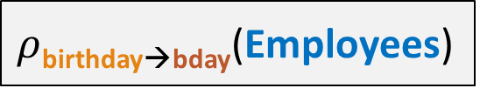
Renaming ($ρ$)
$ρ$_{A1→B1,A2→B2,…}(R) = renames attribute A1 to B1, attribute A2 to B2, …
Employees
SQL query
birthday | first_name | family_name
1990-11-10 | Anne | Smith
2000-02-05 | David | Jones
1995-05-09 | William | Taylor
SELECT DISTINCT birthday AS bday, first_name, family_name
FROM Employees;
translates into
bday | first_name | family_name
1990-11-10 | Anne | Smith
2000-02-05 | David | Jones
1995-05-09 | William | Taylor
$ρ$_{birthday→bday}(Employees)
Relational algebra expression

Slide 14


Selection ($σ$)
The SELECT keyword in SQL has nothing to do with the selection operator!
$σ$_{condition}(R) = set of all tuples in R that satisfy the condition
Employees
SQL query
birthday | first_name | family_name
1990-11-10 | Anne | Smith
2000-02-05 | David | Jones
1995-05-09 | William | Taylor
SELECT DISTINCT * FROM Employees WHERE first_name=‘Anne’;
translates into
birthday | first_name | family_name
1990-11-10 | Anne | Smith
$σ$_{first_name=‘Anne’} (Employees)
Relational algebra expression

Slide 15


Cartesian Product ($×$)
R₁ $×$ R₂ = pairs each tuple in R₁ with each tuple in R₂
Modules
Lecturers
SQL query
code | year | sem
COMP105 | 1 | 1
COMP201 | 2 | 1
name | module
John | COMP105
Sebastian | COMP201
SELECT DISTINCT *
FROM Modules, Lecturers;
translates into
code | year | sem | name | module
COMP105 | 1 | 1 | John | COMP105
COMP105 | 1 | 1 | Sebastian | COMP201
COMP201 | 2 | 1 | John | COMP105
COMP201 | 2 | 1 | Sebastian | COMP201
Modules$×$ Lecturers
Relational algebra expression

Slide 16
Natural Join (⋈)
Employees
birthday | first_name | family_name | e_id
1990-11-10 | Anne | Smith | 1
2000-02-05 | David | Jones | 2
1995-05-09 | William | Taylor | 3
R₁⋈R₂ = pairs each tuple in R₁ with each tuple in R₂
with matching common attributes
Transactions
t_id | c_id | e_id
1 | 3 | 1
2 | 6 | 1
3 | 19 | 3
SELECT DISTINCT *
FROM Employees NATURAL JOIN Transactions;
translates into
birthday | first_name | family_name | e_id | t_id | c_id
1990-11-10 | Anne | Smith | 1 | 1 | 3
1990-11-10 | Anne | Smith | 1 | 2 | 6
1995-05-09 | William | Taylor | 3 | 3 | 19
Employees ⋈ Transactions
Relational algebra expression

Slide 17
Many others…
Besides the mentioned, there are many others, e.g. for:
Left/right semi-join (⋉/⋊)
I.e. returns the rows from the left/right table that would be matched to a row on the other side in a Natural Join – it was covered in SQL queries - optional part
GROUP BY
Relational Algebra for GROUP BY is complex and the two books differ in how they define it (different syntax, symbols and so on) and overall, I feel it is sufficient to know that you CAN define it (both definitions writes down what the GROUP BY statements says and the various aggregates used) and leave it at that

Slide 18
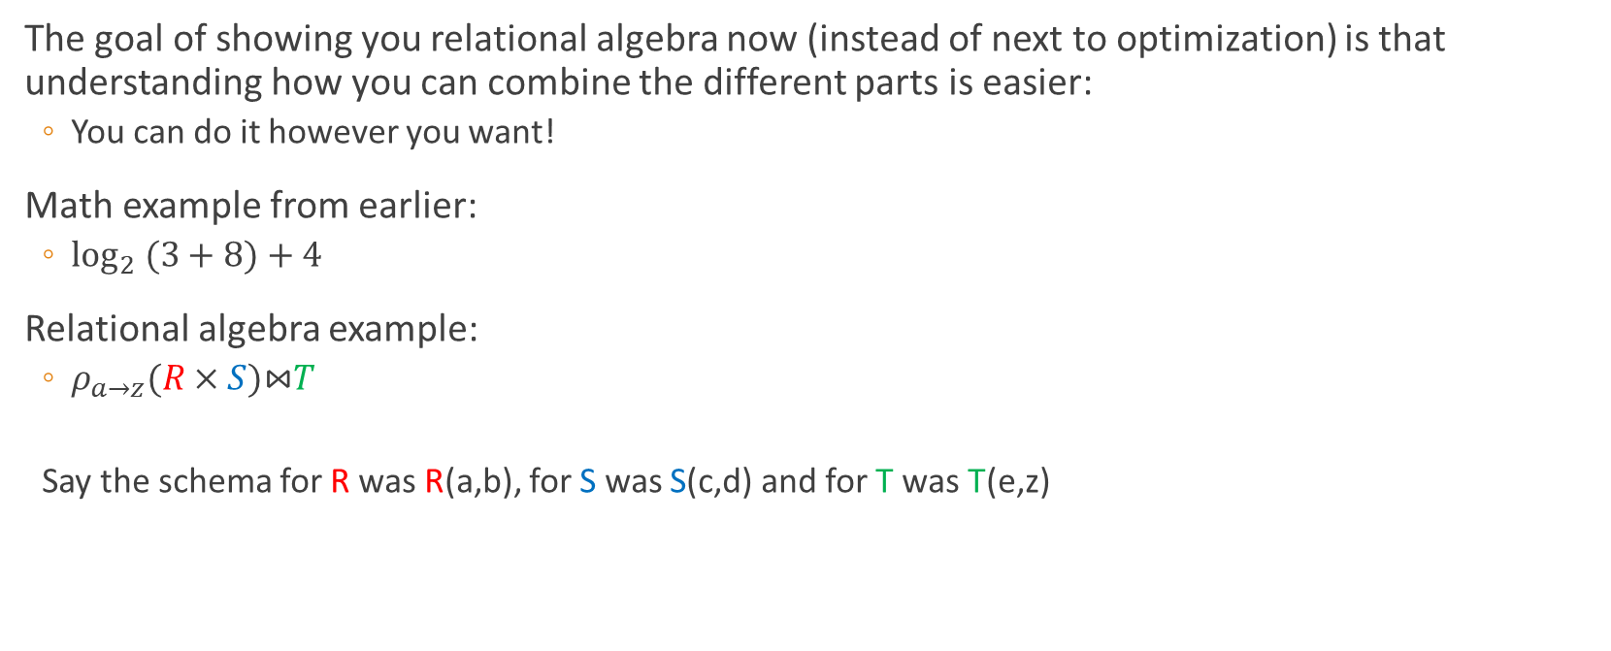
Key understanding
The goal of showing you relational algebra now (instead of next to optimization) is that understanding how you can combine the different parts is easier:
You can do it however you want!
Math example from earlier:
$\log_{2} (3+8)+4$
Relational algebra example:
$ρ_{a→z}(R×S)\text{⋈}T$
Say the schema for R was R(a,b), for S was S(c,d) and for T was T(e,z)
SELECT *
FROM (SELECT a AS z, b, c, d
FROM (SELECT *
FROM R, S)) NATURAL JOIN T;

